Slide 1

Week 2: SQL
Data Science Bootcamp
fall’ 23
Instructor: Kartik Jindgar

Slide 2
About the bootcamp
We have an action-packed agenda!
Week 1
Week 2
Week 3
Week 4
Python
SQL
Numpy & Pandas
Data Visualization

Slide 3
About the bootcamp
We have an action-packed agenda!
Week 5
Week 6
Week 7
Week 8
ML
ML
ML
Project Presentation

Slide 4
Resources
Review the syllabus!
Join the SLACK community – Perfect place to ask your questions and discuss interesting problems!
Visit the GitHub page to access ppts and jupyter notebooks discussed in each section
You can email us at datasciencebootcamp@nyu.edu

Slide 5
Review
Why Python ?
Datatypes
Control Statements
Loops
Functions
Object Oriented Programming

Slide 6
Agenda
Fundamentals of SQL
for Data Science technical interviews

Slide 7
Set up
We will be working with the following tables today
SALES
Date
Order_id
Item_id
Customer_id
Quantity
Revenue
ITEMS
Item_id
Item_name
Price
department
CUSTOMERS
Customer_id
First_name
Last_name
Address

Slide 8

Basic clauses

Slide 9
Syntax:
SELECT columns
FROM table
We can use wildcard character * to select all columns.
We can also use Limit at the end of the query to limit the number of records fetched
Eg:
SELECT *
FROM sales
LIMIT 10
SALES – Date, Order_id, Item_id, Customer_id, Quantity, Revenue

Slide 10
Syntax:
SELECT columns
FROM table
WHERE condition
We can use Where clause to filter the rows that are fetched by our query
Some of the operators that we can use are – LIKE, =, >,<, IS NULL, IN, BETWEEN, etc.
Eg: Pull sample of 20 sales from 05 January 2023
SALES – Date, Order_id, Item_id, Customer_id, Quantity, Revenue

Slide 11
Syntax:
SELECT columns
FROM table
WHERE condition
We can use Where clause to filter the rows that are fetched by our query
Some of the operators that we can use are – LIKE, =, >,<, IS NULL, IN, BETWEEN, etc.
Eg: Pull sample of 20 sales from 05 January 2023
SELECT *
FROM sales
WHERE data = “01-05-2023”
LIMIT 20
SALES – Date, Order_id, Item_id, Customer_id, Quantity, Revenue

Slide 12
Common aggregate function s
COUNT(column)
count all non null values in the column
count(*) will count all rows in the table
COUNT( DISTINCT column)
count all distinct values in the column
SUM(column) and AVG(column)
calculates the sum and average of a column
MIN(column) and MAX(column)
computes the max and min value in a column

Slide 13
Syntax:
SELECT columns,
aggregate_fun (column)
FROM table
WHERE condition
GROUP BY columns
We must group by all non aggregate columns
Eg: For each day in January 2023 how much revenue
did we generate and how many sales did we have?
SALES – Date, Order_id, Item_id, Customer_id, Quantity, Revenue

Slide 14
Syntax:
SELECT columns,
aggregate_fun (column)
FROM table
WHERE condition
GROUP BY columns
We must group by all non aggregate columns
Eg: For each day in January 2023 how much revenue
did we generate and how many sales did we have?
SELECT date,
SUM(revenue) as rev,
COUNT(distinct order_id) as sales
FROM sales
WHERE date between
“01-01-2023” and “01-31-2023”
GROUP BY date
SALES – Date, Order_id, Item_id, Customer_id, Quantity, Revenue

Slide 15
Syntax:
SELECT columns
aggregate_fun (column)
FROM table
WHERE condition
GROUP BY columns
ORDER BY columns ASC/DESC
We can sort the rows based on certain columns
Eg: How many items do we have in each department. Sort
the departments in descending order
Items – item_id, item_name, price, department

Slide 16
Syntax:
SELECT columns
aggregate_fun (column)
FROM table
WHERE condition
GROUP BY columns
ORDER BY columns ASC/DESC
We can sort the rows based on certain columns
Eg: How many items do we have in each department. Sort
the departments in descending order
SELECT department,
COUNT(*) as items,
FROM items
GROUP BY department [or 1]
ORDER BY items [or 2]
Items – item_id, item_name, price, department

Slide 17
Syntax:
SELECT columns
aggregate_fun (column)
FROM table
WHERE condition
GROUP BY columns
HAVING condition
The ‘Having’ clause acts like a ‘Where’ condition for your aggregate columns
Eg: Pull any order that cost at least $1000 sorted by
order revenue descending.
SALES – Date, Order_id, Item_id, Customer_id, Quantity, Revenue

Slide 18
Syntax:
SELECT columns
aggregate_fun (column)
FROM table
WHERE condition
GROUP BY columns
HAVING condition
The ‘Having’ clause acts like a ‘Where’ condition for your aggregate columns
Eg: Pull any order that cost at least $1000 sorted by
order revenue descending.
SELECT order_id,
SUM(revenue) as rev,
FROM SALES
GROUP BY order_id [or 1]
HAVING rev >=1000
ORDER BY rev [or 2] desc
SALES – Date, Order_id, Item_id, Customer_id, Quantity, Revenue

Slide 19
Sql column functions

Slide 20
Sql column functions
CASE WHEN * THEN *
[WHEN * THEN * ELSE *] END
An IF/THEN statement for SQL
CAST(column AS dtype)
Changes a column’s datatype (int64, string, float64 are the most common dtypes)
UPPER() and LOWER()
Adjusts the case of a string field for easier string matching
LIKE ‘%string%’
To match on ‘string’ with % acting as a wildcard (this is actually a conditional, not a function)

Slide 21
Sql column functions
Eg: What was the average order value in 2022
CASE WHEN * THEN *
[WHEN * THEN * ELSE *] END
An IF/THEN statement for SQL
CAST(column AS dtype)
Changes a column’s datatype (int64, string, float64 are the most common dtypes)
UPPER() and LOWER()
Adjusts the case of a string field for easier string matching
LIKE ‘%string%’
To match on ‘string’ with % acting as a wildcard (this is actually a conditional, not a function)
SALES – Date, Order_id, Item_id, Customer_id, Quantity, Revenue

Slide 22
Sql column functions
Eg: What was the average order value in 2022
SELECT SUM(revenue) /
COUNT(distinct order_id) as
revenue_per_order
FROM SALES
WHERE CAST(date AS string)
like “%-%-2022”
CASE WHEN * THEN *
[WHEN * THEN * ELSE *] END
An IF/THEN statement for SQL
CAST(column AS dtype)
Changes a column’s datatype (int64, string, float64 are the most common dtypes)
UPPER() and LOWER()
Adjusts the case of a string field for easier string matching
LIKE ‘%string%’
To match on ‘string’ with % acting as a wildcard (this is actually a conditional, not a function)
SALES – Date, Order_id, Item_id, Customer_id, Quantity, Revenue

Slide 23
joins

Slide 24
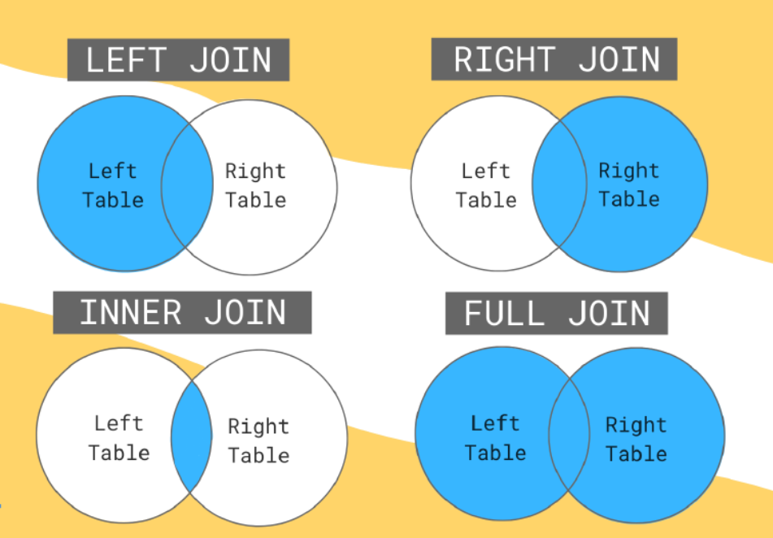

Slide 25
Syntax:
SELECT columns
FROM table1 as A
JOIN* table2 as B
On A.column = B.column
The join key should be specified using its column name in each table.
You can join on several keys by using AND A.key2=B.key2, etc.
Eg: How much revenue has every item we sell generated?
SALES – Date, Order_id, Item_id, Customer_id, Quantity, Revenue
ITEMS – Item_id, Item_name, price, department

Slide 26
Syntax:
SELECT columns
FROM table1 as A
JOIN* table2 as B
On A.column = B.column
The join key should be specified using its column name in each table.
You can join on several keys by using AND A.key2=B.key2, etc.
Eg: How much revenue has every item we sell generated?
SELECT i.item_id
SUM(s.revenue) as rev,
FROM Items as i
Left Join sales as s
On i.item_id = s.sales_id
GROUP BY 1
SALES – Date, Order_id, Item_id, Customer_id, Quantity, Revenue
ITEMS – Item_id, Item_name, price, department

Slide 27
Syntax:
SELECT columns
FROM table1 as A
JOIN* table2 as B
On A.column = B.column
The join key should be specified using its column name in each table.
You can join on several keys by using AND A.key2=B.key2, etc.
Eg: How much revenue has every item we sell generated?
SELECT i.item_id
COALESCE(SUM(s.revenue),0) as rev,
FROM Items as i
Left Join sales as s
On i.item_id = s.sales_id
GROUP BY 1
SALES – Date, Order_id, Item_id, Customer_id, Quantity, Revenue
ITEMS – Item_id, Item_name, price, department

Slide 28
Subqueries

Slide 29
Syntax:
SELECT columns
FROM table
WHERE column_val [<,>,IN, etc.]
(SELECT ...)
Subqueries are SQL queries that are nested inside a larger query. They can be used in the SELECT, FROM, WHERE and/or HAVING statements.
Typically, when using a subquery in the SELECT, WHERE or HAVING statements, the subquery must only return one value.
Eg: Pull the sales that generated more revenue than order ‘2567’.
SALES – Date, Order_id, Item_id, Customer_id, Quantity, Revenue

Slide 30
Syntax:
SELECT columns
FROM table
WHERE column_val [<,>,IN, etc.]
(SELECT ...)
Subqueries are SQL queries that are nested inside a larger query. They can be used in the SELECT, FROM, WHERE and/or HAVING statements.
Typically, when using a subquery in the SELECT, WHERE or HAVING statements, the subquery must only return one value.
Eg: Pull the sales that generated more revenue than order ‘2567’.
SELECT order_id,
SUM(revenue) as rev
FROM sales
GROUP BY order_id
HAVING rev > (
SELECT SUM(revenue)
FROM sales
WHERE order_id = ‘2567’)
SALES – Date, Order_id, Item_id, Customer_id, Quantity, Revenue

Slide 31
Things to keep in mind

Slide 32
Tips
Pay attention to the order of tables when you are joining them

Slide 33
Tips
Remember to group by every column you aren’t aggregating

Slide 34
Tips
You are not required to COALESCE over all null values.
We typically only coalesce numerical values when we want to capture all entries including those with no ‘value’.

Slide 35
Tips
When using a conditional for null values, you cannot use ‘=’ and MUST use ‘IS NULL’

Slide 36
Tips
Use distinct when values might be duplicated across multiple rows.
Don’t use distinct on a table’s key- it isn’t necessary to dedupe a key that is unique.

Slide 37
Tips
Make sure you are talking about your code and thought process while you write it!
Interviewers want to know that you understand what you are doing!

Slide 38
Practice questions

Slide 39
Write a sql query to -
Pull total number of orders that were completed on 18th March 2023
Pull total number of orders that were completed on 18th March 2023 with the first name ‘John’ and last name ‘Doe’
Pull total number of customers that purchased in January 2023 and the average amount spend per customer
Pull the departments that generated less than $600 in 2022
What is the most and least revenue we have generated by an order
What were the orders that were purchased in our most lucrative order

Slide 40
QnA

